Slide 1
Natural Language DB Query
QA system for class grading
Fernando Granato
Yu Chen
Wenzhe Yang
Sneha Sarkar

Slide 2
Presentation Overview
Research Question
System Design
Scope
Complexity
Potential problems
Solutions
NLP Techniques
Stanford Dependency Parser
NLTK Chunk Package
Synonyms Substitution
System Demonstration
Interpretation of the Results and Potential Applications

Slide 3
Research Question and Project Overview
The problem: Querying a database structure using natural language questions and answer - QA - system.
Examples:
Question: "What was the average score for assignment 1?"
Answer: "Average score for assignment 1 is 78,1."
Question: "Who had the best grade on exam 2?
Answer: "Shelley Hughes, Ann Kelly and Claude Rodriquez."
Question: "From those who scored more than 80% on exam 1, what is the average score?"
Answer: "The average score for those who scored more than 80% on exam 1 is 90.95".

Slide 4
System Design
Scope:
Process simple natural language questions to retrieve data from a pre-built database
Database:
Randomly generated data for 50 students: first name, last name, 5 assignment scores and 2 exam scores
Scores were generated using a normal distribution
Mean = 80
Standard deviation = 10

Slide 5
System Design
Complexity:
How to translate natural language question into a structured database query and retrieve the proper results?
Natural language is flexible and db query is strict
One sentence may contain multiple parts of information: calculation, condition and formatting
"From those who scored more than 80% on exam 1" - Condition is exam1 > 80%
"what is the average score?" - Calculation is average

Slide 6
System Design
Solution:
Database
User Interface
Question Parsing
Data retrieving
Answer generation

Slide 7
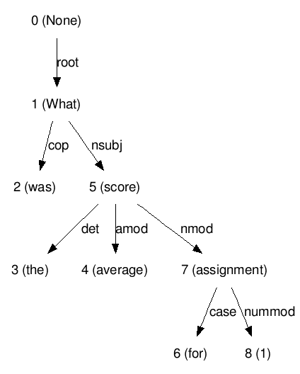
NLP Tools and Techniques
Stanford Dependency Parser:
Powered by a neural network, the parser outputs typed dependencies between words on a sentence.
On the example: What was the average score for assignment 1?

Slide 8
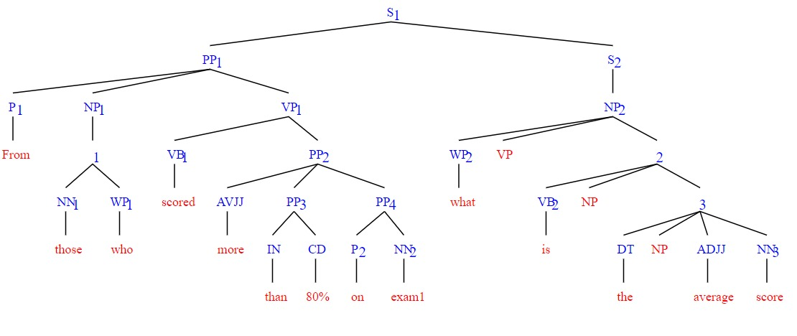
NLP Tools and Techniques
NLTK Chunk Package: A processing interface to identify non-overlapping groups in unrestricted text. Typically, chunk parsers are used to find base syntactic constituents, such as base noun phrases.

Slide 9
NLP Tools and Techniques
Synonyms Substitution: users may refer to the same concept using different words or expressions. Synonym substitution should process the question to extract meaning from groups of words (bigrams, trigrams) and transform them to make it easier for the system to understand them.
What is the average score on assignment 1 / What is the mean for assignment 1?
average = mean
What is Julie`s score for assignments 1 and 2? / What is Julie`s score for the first two assignments?
assignments 1 and 2 = first two assignments = assignment1 assignment2

Slide 10
System Demonstration

Slide 11
Results
Limitations:
Specific for our pre built DB
Make it flexible by processing the data before loading it
Few types of questions
Use more sophisticated NLP techniques and tools to deal with more sentence structures
Using input questions to improve meaning extraction - ML
More visualization:
Implement charts, tables and other visualizations

Slide 12
Results
Potential:
Making DB querying more accessible
Natural interaction with users
Input / Delete / Update commands
No visual outcome

Slide 13
Thank you!

